Slide 1
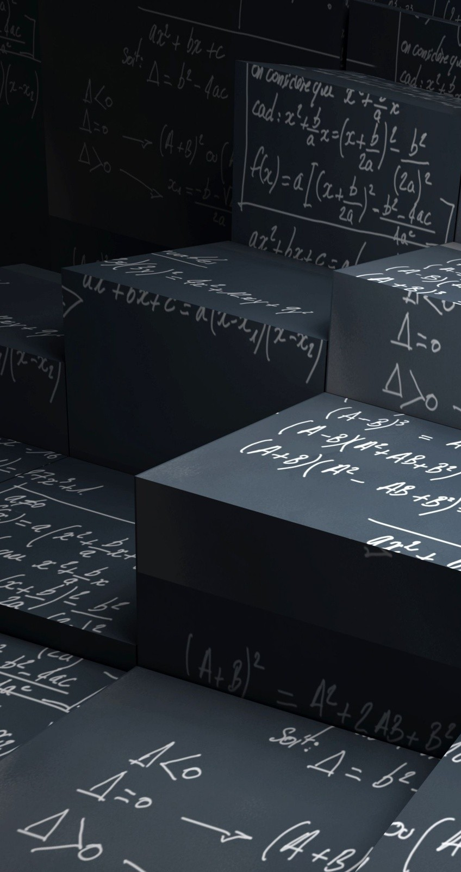
Review of Mathematics PART 2
This lesson will ensure that you have the necessary math skills to successfully complete this course. Many of the skills from grade ten math and science will be reviewed.

Slide 2
Learning Goals
By the end of this lesson, you will be able to:
apply basic trigonometry
apply the Sine Law
apply the Cosine Law

Slide 3
Success Criteria
Can I:
solve for sides and angles of right triangles using basic trigonometry with a high degree of accuracy
apply the Sine law to solve non-right triangles with a high degree of accuracy
apply the Cosine law to solve non-right triangles with a high degree of accuracy

Slide 4
applying basic trigonometry
trig is used to solve triangles
when considering this angle
this is the opposite side
this is the hypotenuse
θ
this is the adjacent side

Slide 5
applying basic trigonometry
trig is used to solve triangles
when considering this angle
θ
this is the adjacent side
this is the hypotenuse
this is the opposite side

Slide 6
there are three basic trigonometric ratios
SOH CAH TOA

Slide 7
PRACTICE Problem
1. Solve for θ in
5.0 m
θ
4.0 m

Slide 8
PRACTICE Problem
2. Solve for x in
5.0 m
x
4.0 m

Slide 9
applying Sine Law
the previous trig ratios can only be used if you have
a right triangle
if the triangle is not right, then you must use sine
and/or cosine law
C
a
b
B
A
c
normally sine law is used if you have two angles
and one side or two sides and the opposite angle

Slide 10
PRACTICE Problem
3. Solve for b in
105º
b
25º
6.5 cm

Slide 11
applying COSine Law
C
a
b
B
A
c
normally cosine law is used if you have two sides
and the adjacent angle. ie: a,c and B

Slide 12
PRACTICE Problem
4. Solve for a in
a
1.0 m
75º
3.5 m

Slide 13
PRACTICE Problem
5. Cosine law can also be used to solve for an angle if
you have all three sides. Solve for θ
θ
4.2 m
2.0 m
5.5 m

Slide 14
HOMEWORK
Review lesson material
Are You Ready for Unit One # 9 – 13 pg 5

